Slide 1
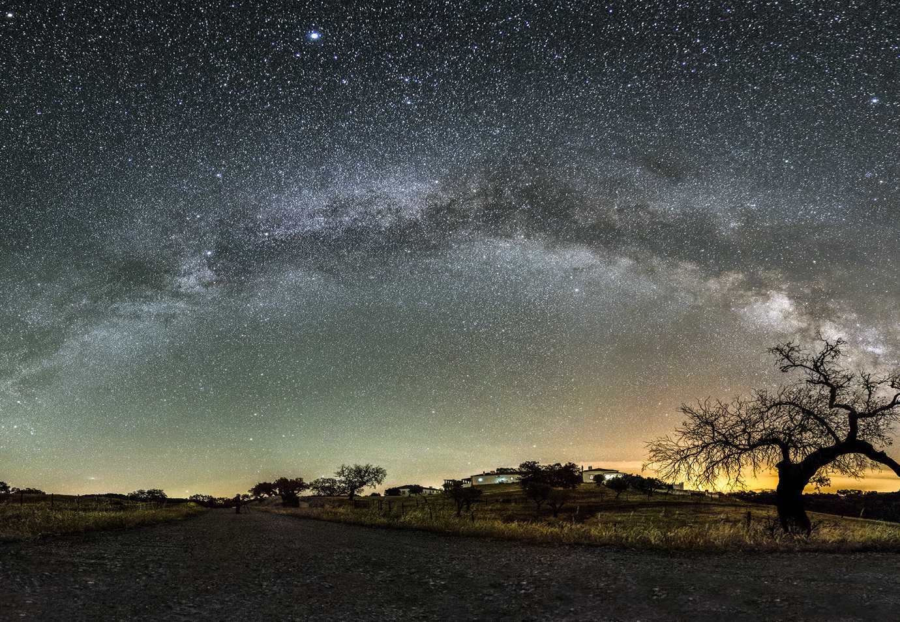

The Missing Baryon Component:
A search for the Cosmic Web using the Cosmic Microwave Background
Mitchell de Zylva, Supervised by Dr Christian Reichardt
Notes:
Astronomy and Astrophysics has been in a golden age for the last ten years. Advances in technology, intelligent mobilisation of resources, and unprecedented access to facilities, experiments, and data have produced some of the largest and most comprehensive studies the fields have ever seen. A single experiment will produce hundreds of terabytes of data, necessitating complex data pipelines and the collaboration of hundreds of individuals, simply to extract meaningful information from it. This presents a problem however. Recently, there has been an increase in the number of measurements of fundamental cosmic parameters at high redshift and at low redshift. Perhaps the best known is the recent Hubble constant tension, which has now exceeded 5 sigma. There now exists a not insignificant portion of the field who find themselves now working to bring these competing results into alignment.

Slide 2
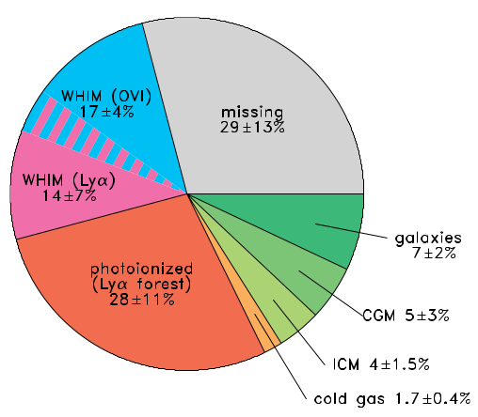
Baryon Census at redshift z<2
Baryon Fraction
Source | Baryon Fraction
CMB | (0.0224 ± 0.0001) h⁻²
Lyman α Forest | > (0.0172) h⁻²
Light Element Ratios and Big Bang Nucleosynthesis | (0.019 ± 0.0001) h⁻²
Source: Shull et al. 2012
Notes:
One well known problem in astronomy is that of missing baryons. At high redshifts, it is comparatively simple to make an account for baryonic matter, since it mainly exists in a single phase. The Cosmic Microwave Background provides an accurate measure of the Baryon Content because the characteristic pattern in it is very sensitive to the proportional amount of baryons, radiation, and dark matter in the primordial fluid. Until a redshift of approximately 2, the baryons can also be found very easily in the absorption spectra of distant quasars, in something called the Lyman-Alpha forest. But below this, the baryons have evolved into a broad phase space, with temperatures ranging from a few kelvin to 10^7 K, and densities from that of stars to disperse gas. Taking an account of the baryon component in stars, galaxies, and residual gas clouds, leaves a defecit of between 30 to 50 percent of the known baryon component at high redshift. So this begs the question of where these baryons have gone.

Slide 3
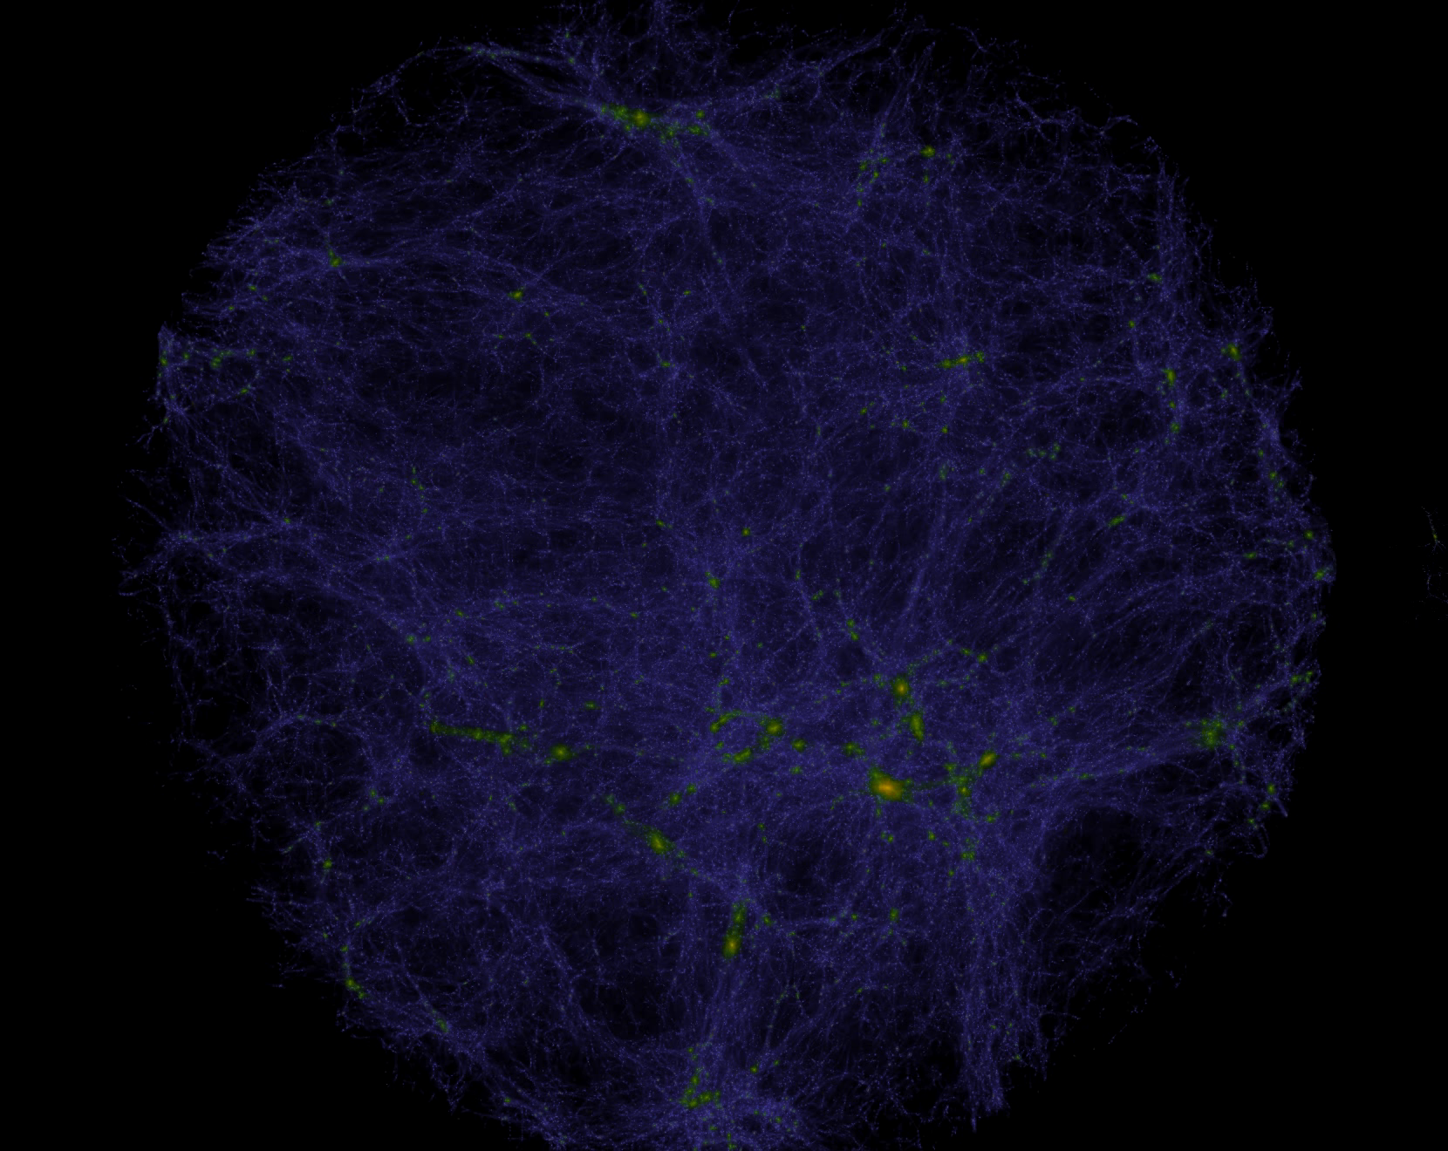
Large-Scale Structure
Credit: dragons Simulations/The University of Melbourne
1
Notes:
This is an image of the large scale structure of the universe, taken from the Dragons simulations. If we examine the phase space of baryons given by high resolution hydrodynamic simulations, we see that the filamentary structure in between galaxies exists in a very disperse, very high temperature phase known as the Warm Hot Interstellar Medium.

Slide 4
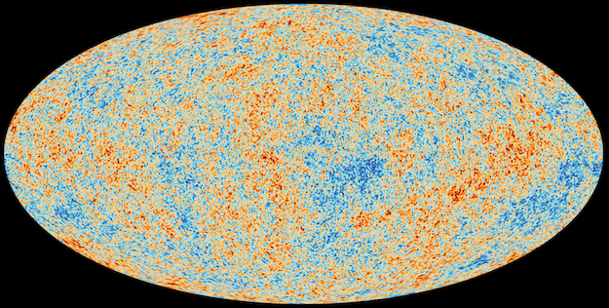
Cosmic Microwave Background
1
Credit: Planck Collaboration/European Space Agency
Notes:
We use the CMB, in an effort to make a detection of this missing matter. As the photons of the CMB travel from the surface of last scattering, they will interact with the intervening large scale structure, producing spectral distortion in the CMB. These spectral distortions can be separated from the CMB, because they behave fundamentally differently to the pattern inherent to the CMB

Slide 5
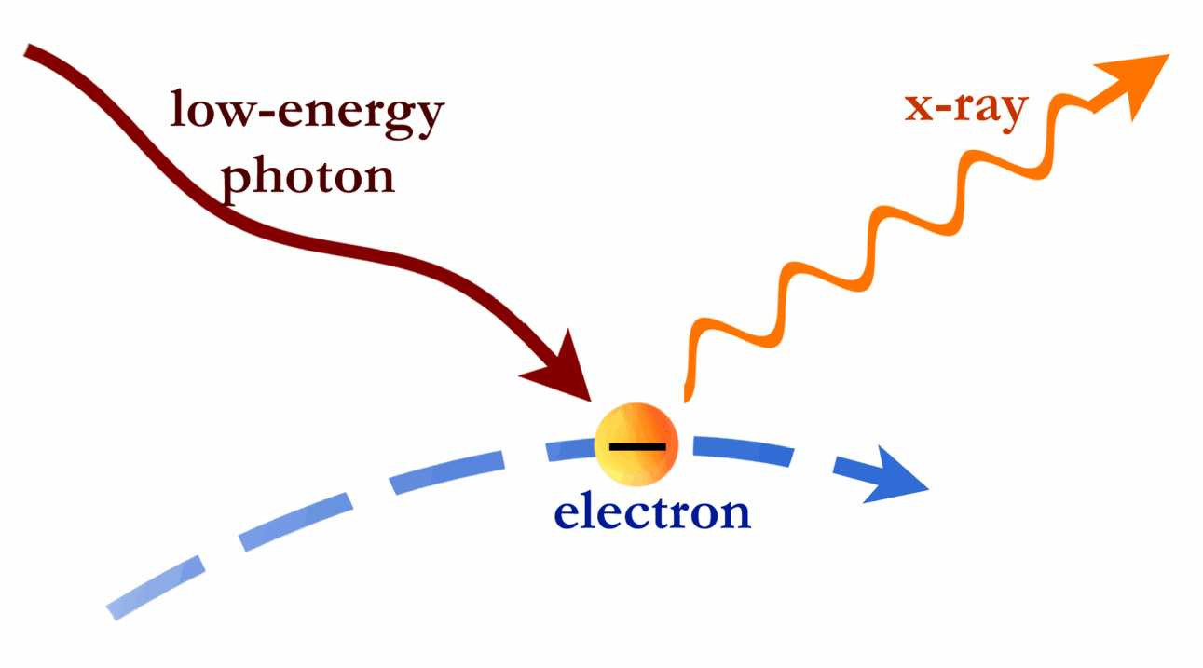
Inverse Compton Scattering
1
Credit: Chandra Observatory/Harvard University
Notes:
The clearest of these distortions is the thermal Sunayev Zeldovich effect, or tSZ, the inverse compton scattering of cmb photons off of hot gas. Photons travelling from the surface of last scattering will absorb energy from the intervening hot gas.

Slide 6
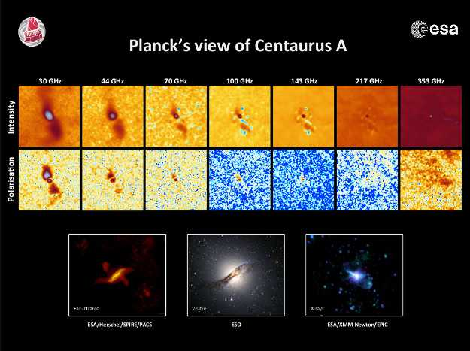
Thermal Sunayev Zeldovich Effect (tSZ)
1
Credit: Planck Collaboration/European Space Agency
Notes:
This distortion is very small, and has different strengths at different wavelengths. For a known galaxy cluster, we see a signal something like what is shown here. But the missing baryons are much more disperse than this, so the signal to noise ratio for a single filament is about 10^-8.

Slide 7
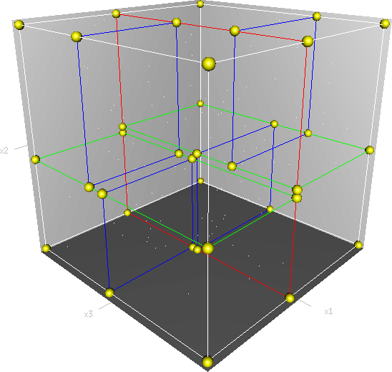
K Dimensional Tree
Notes:
Doing this requires the use of a k dimensional tree and a nearest neighbours search algorithm. As one would expect, galaxies which are closer together are more likely to have a filament connecting them. So we search for galaxies within certain separations of each other.

Slide 8
Stacking Algorithm
Notes:
Once these galaxies are paired up, we look for their pair in the Cosmic Microwave Background, and cut out an image of them. We then rotate them until they are aligned, and stack them on top of each other.

Slide 9
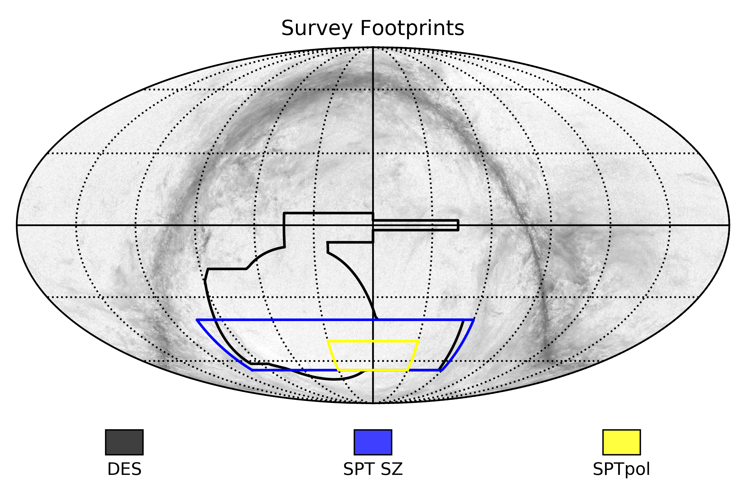
Datasets
Notes:
We chose to use the Dark Energy Survey, and the CMB measurements from the South Pole Telescope for this analysis, primarily due to the high precision in the CMB that is afforded by the South Pole Telescope when compared to the Planck Satellite. However, the errors assosciated with the Dark Energy Survey’s redshifts do provide a source of error.
Using the Dark Energy Survey, and a 500 square degree fraction of the sky, shown by the SPTpol area, we find more than 700,000 galaxy pairs with transverse separations between 4 and 20 Mega parsecs, and line of sight separations less than 20 Megaparsecs.

Slide 10
$y_{h}\left(p\right)=y_{L,i}+y_{R,j}$
Notes:
When we perform the stack, we see two bright spots where the galaxy halos are stacked, as well as brighter signal indicating the filament connecting them.
The plots above and below the image show slices through the centre of the two halos, and through the left halo only.

Slide 11
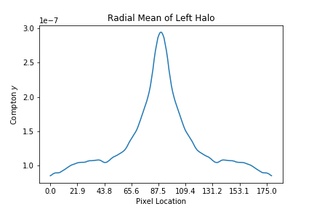
Radial Mean of Halos
Notes:
Next, we need to subtract away the halo contribution for each pixel. We first fit to a radial mean of a single halo. This gives a good initial estimate, but doesn’t take into acocunt the necessity for a contribution from both halos at every point.

Slide 12
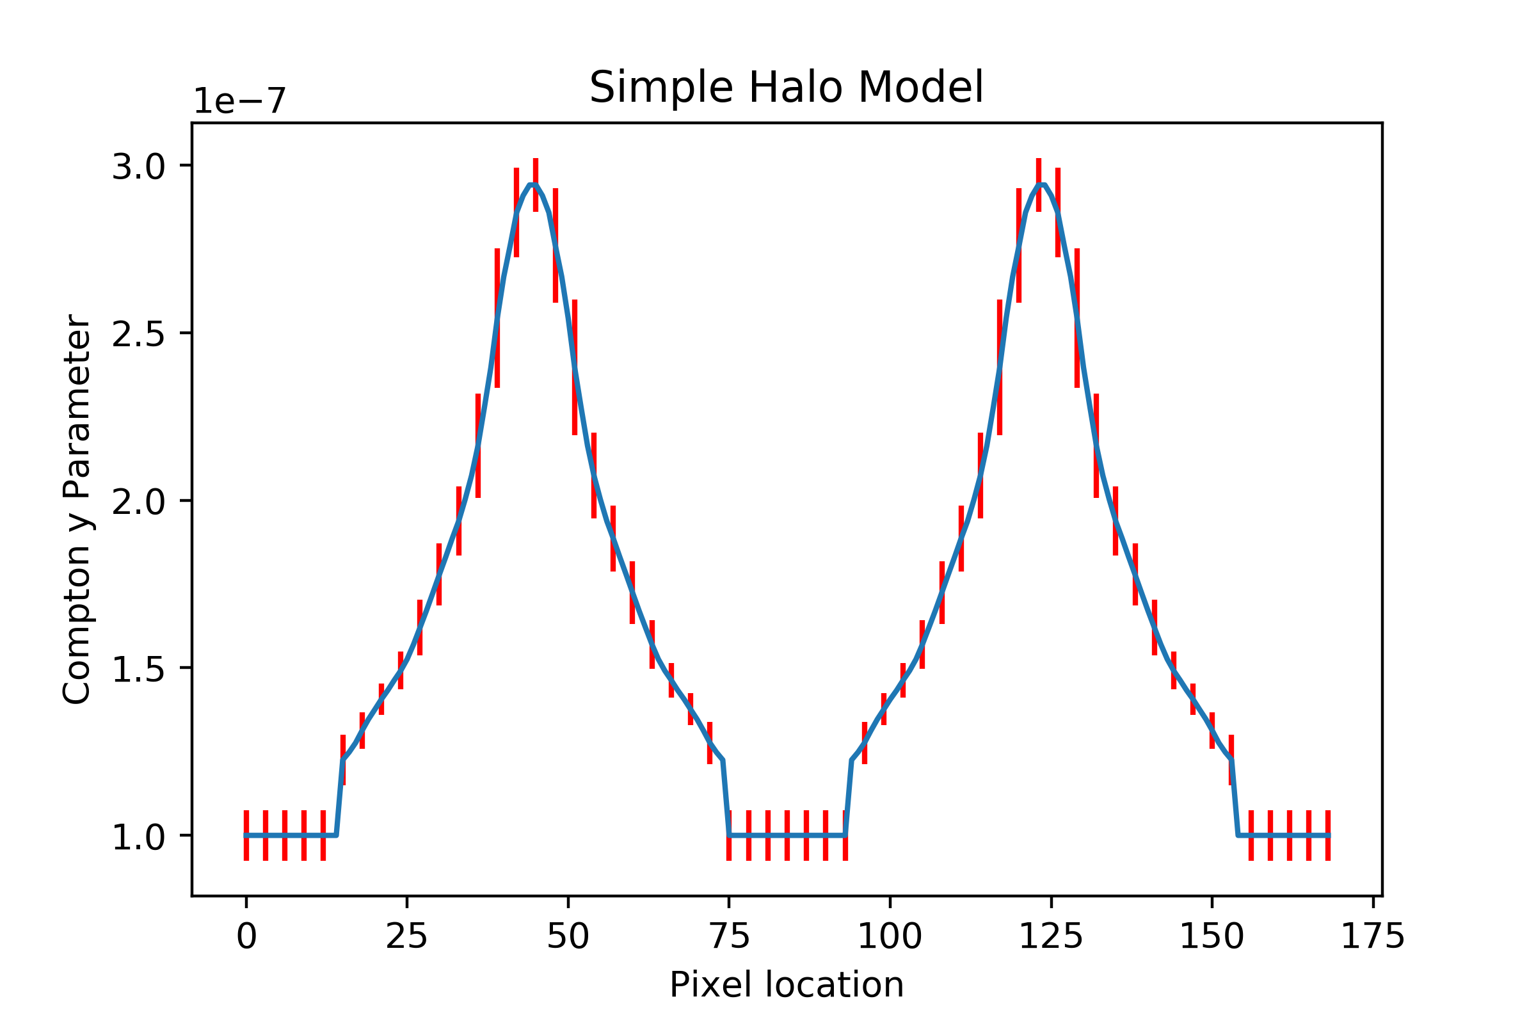
Naive Halo Model

Slide 13
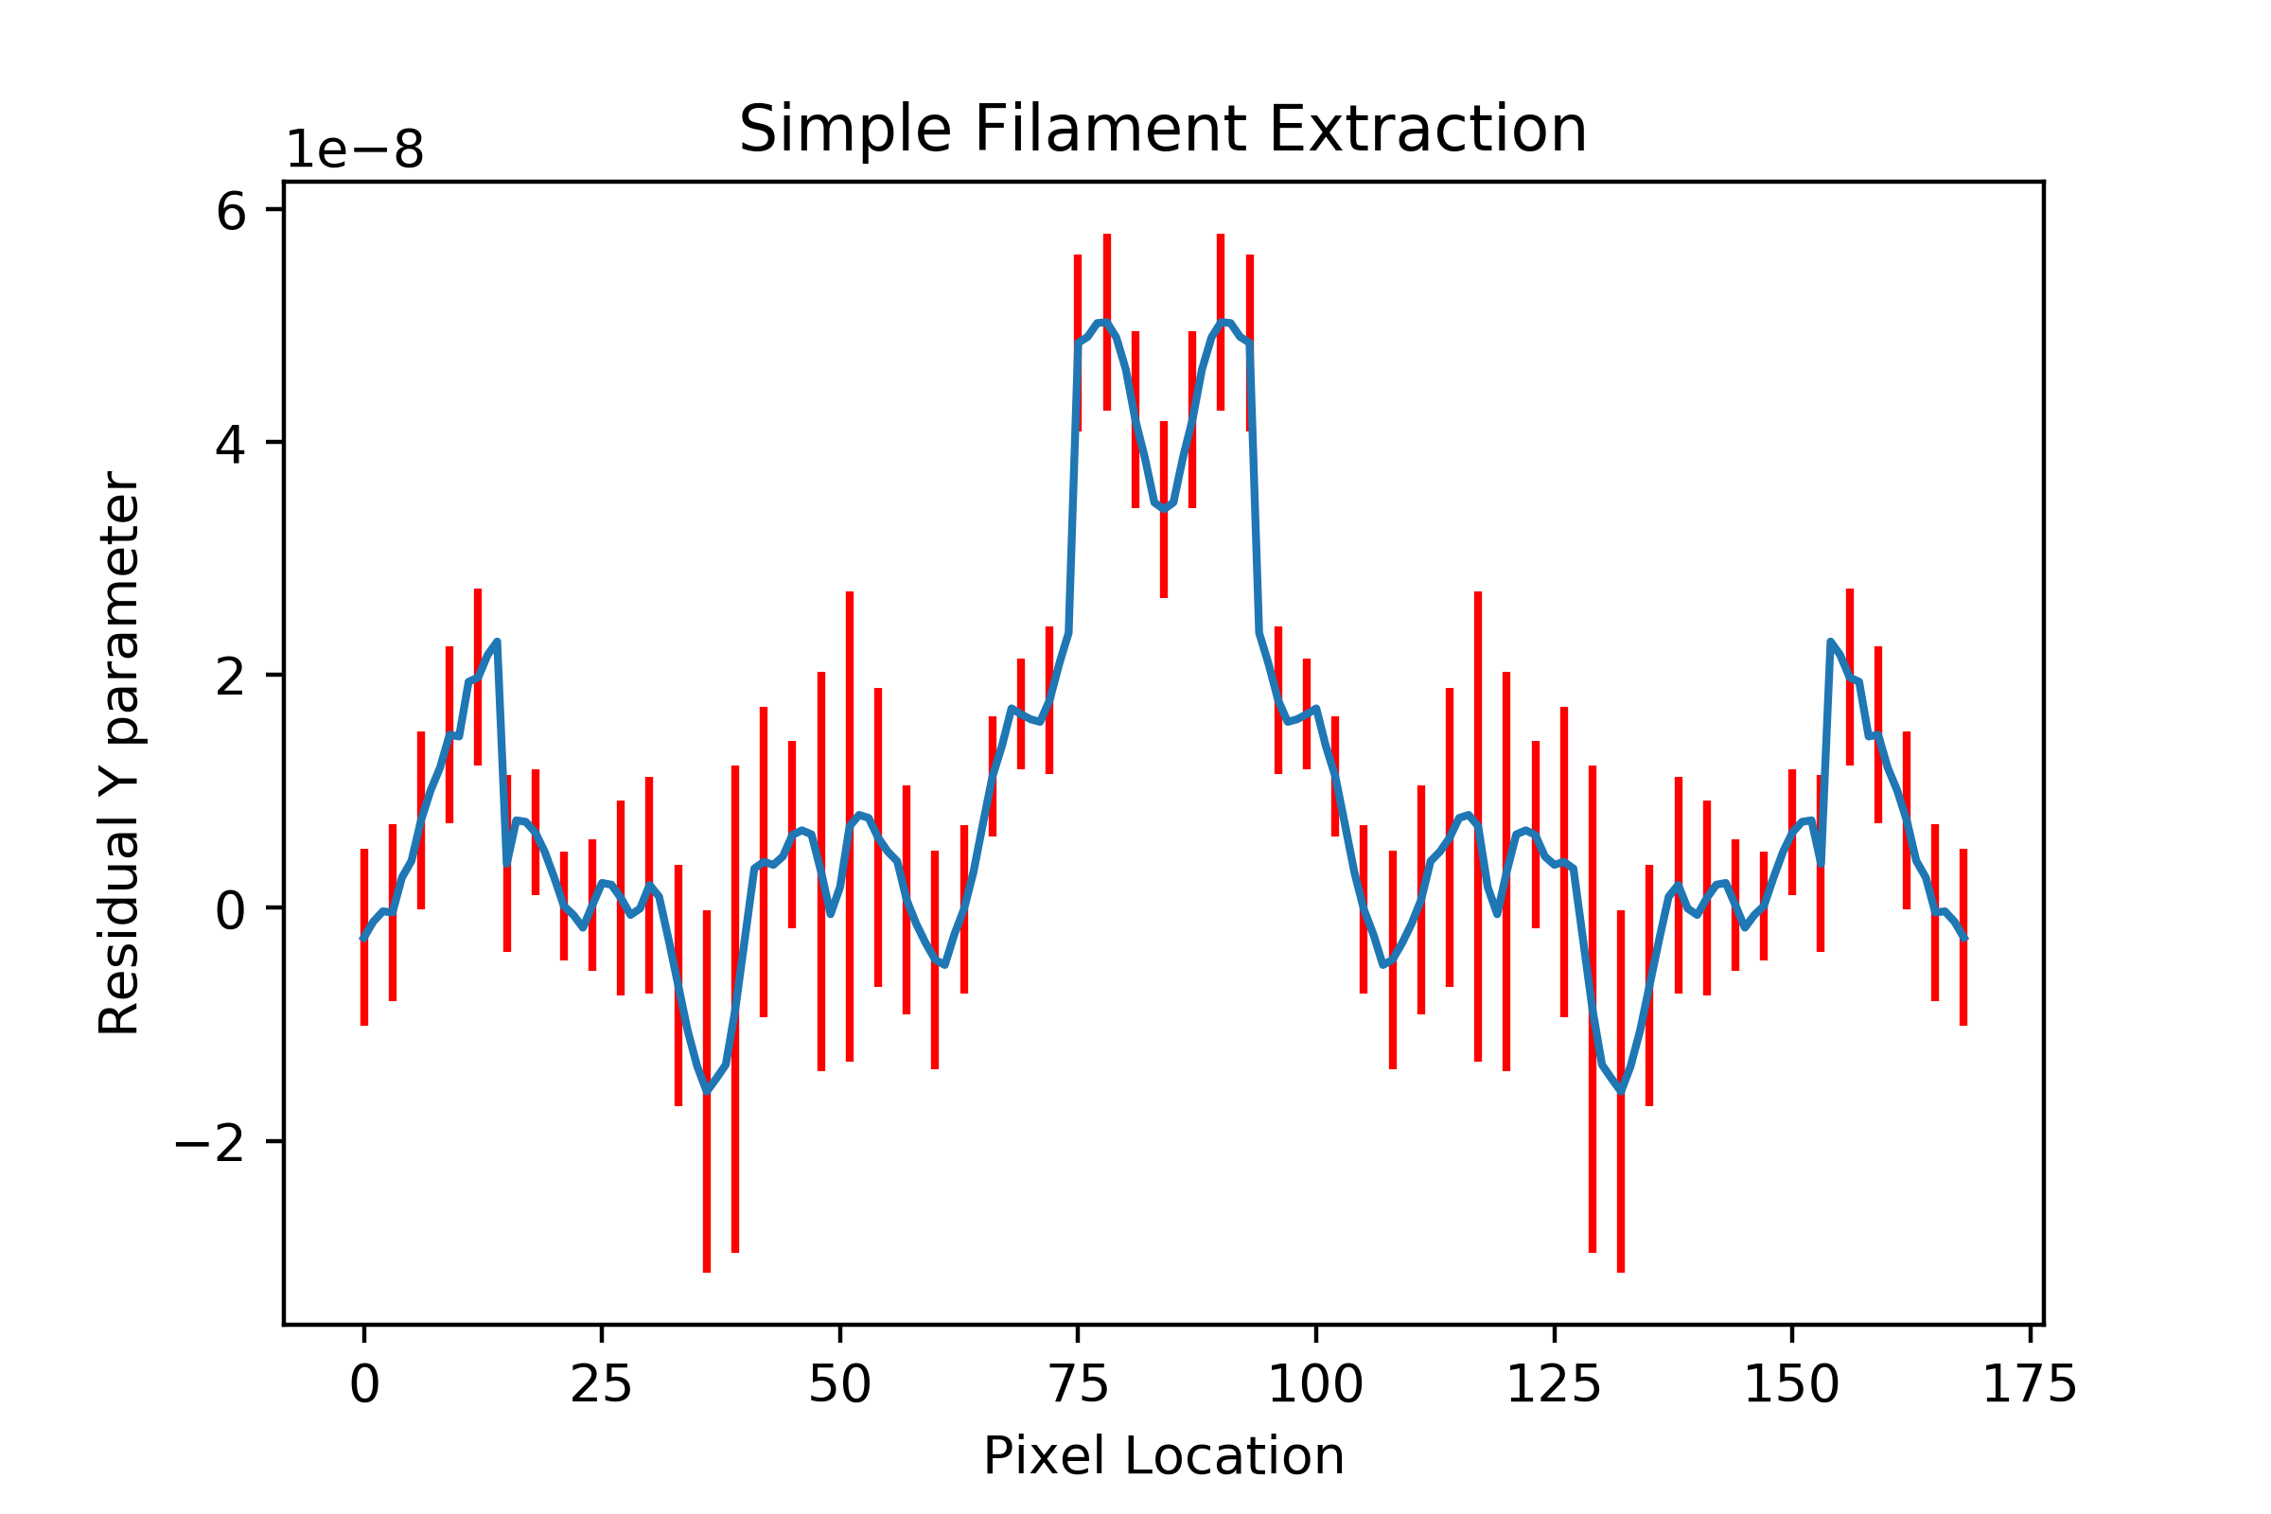
Simple Filament

Slide 14
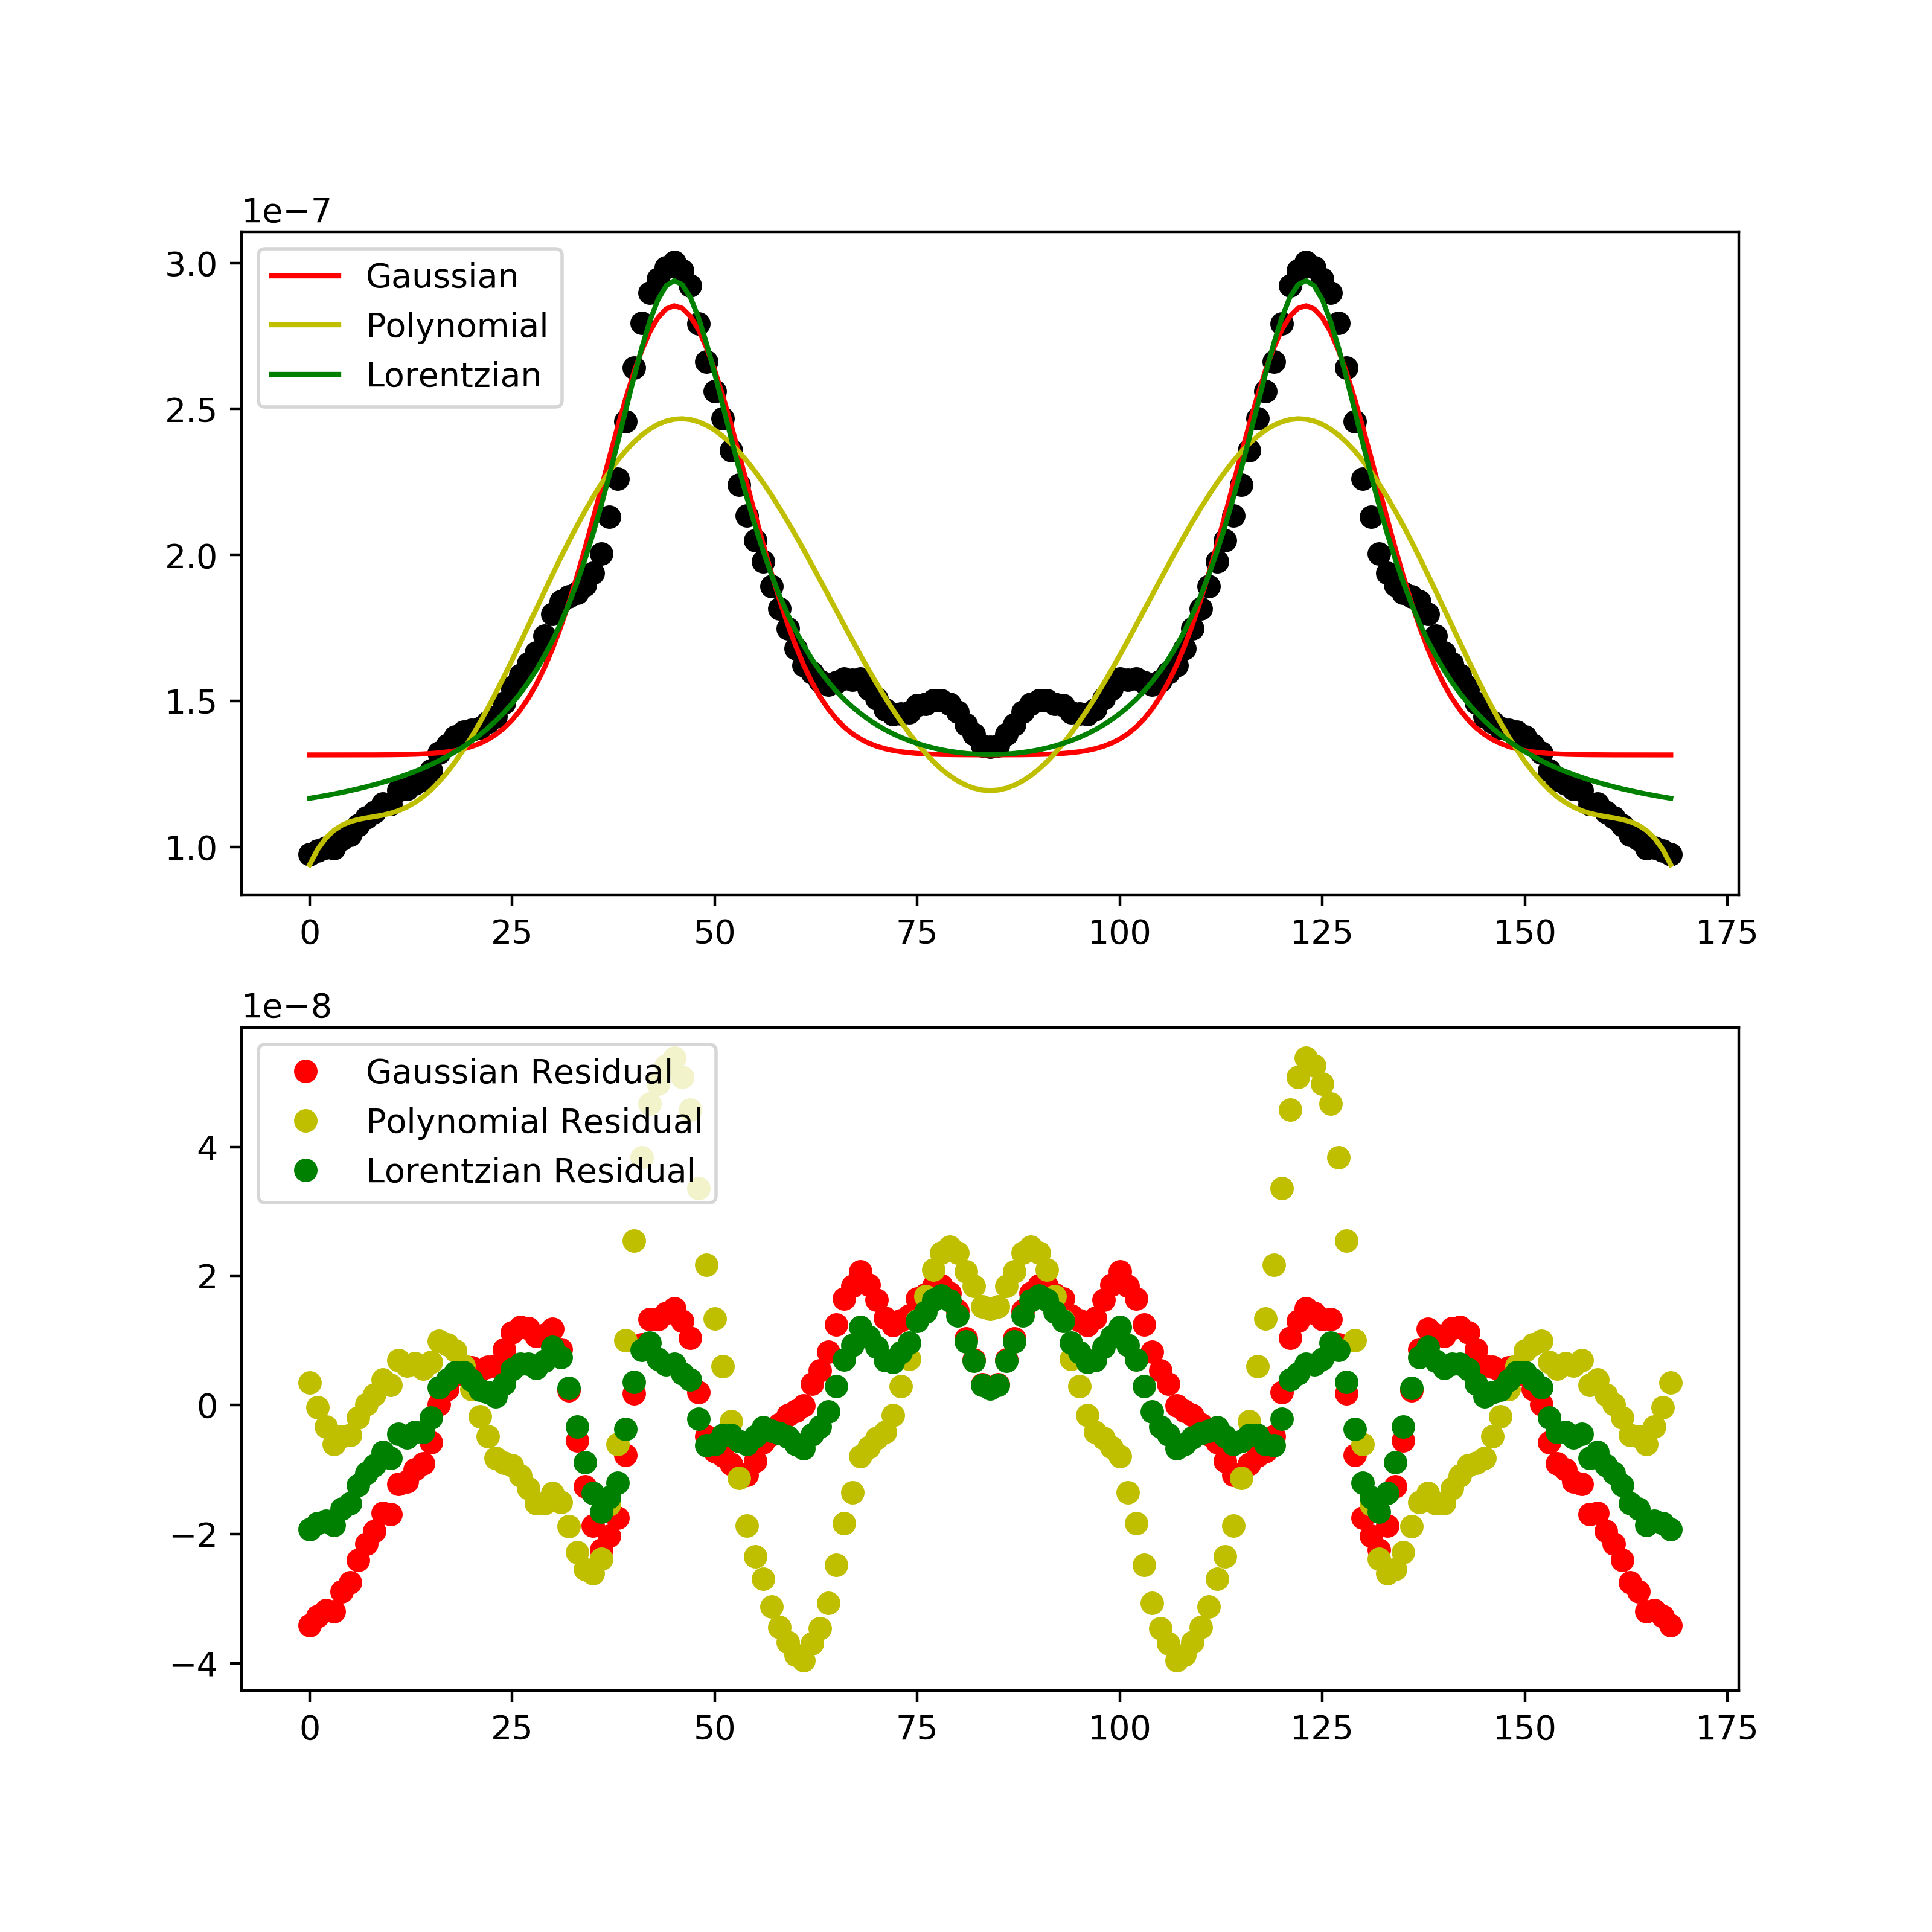
Notes:
Making this assumption, fitting can be performed for two independent halos.Guessing for gaussians, fourth order polynomials, and for interest, lorentzians, gives the following models, and the remaining residual signal.
Performing this operation, and choosing a model that matches best with some underlying assumptions of the halo shape, leaves a mean residual signal of approximately 1.29 times 10^-8 as the measure of the filament signal.

Slide 16
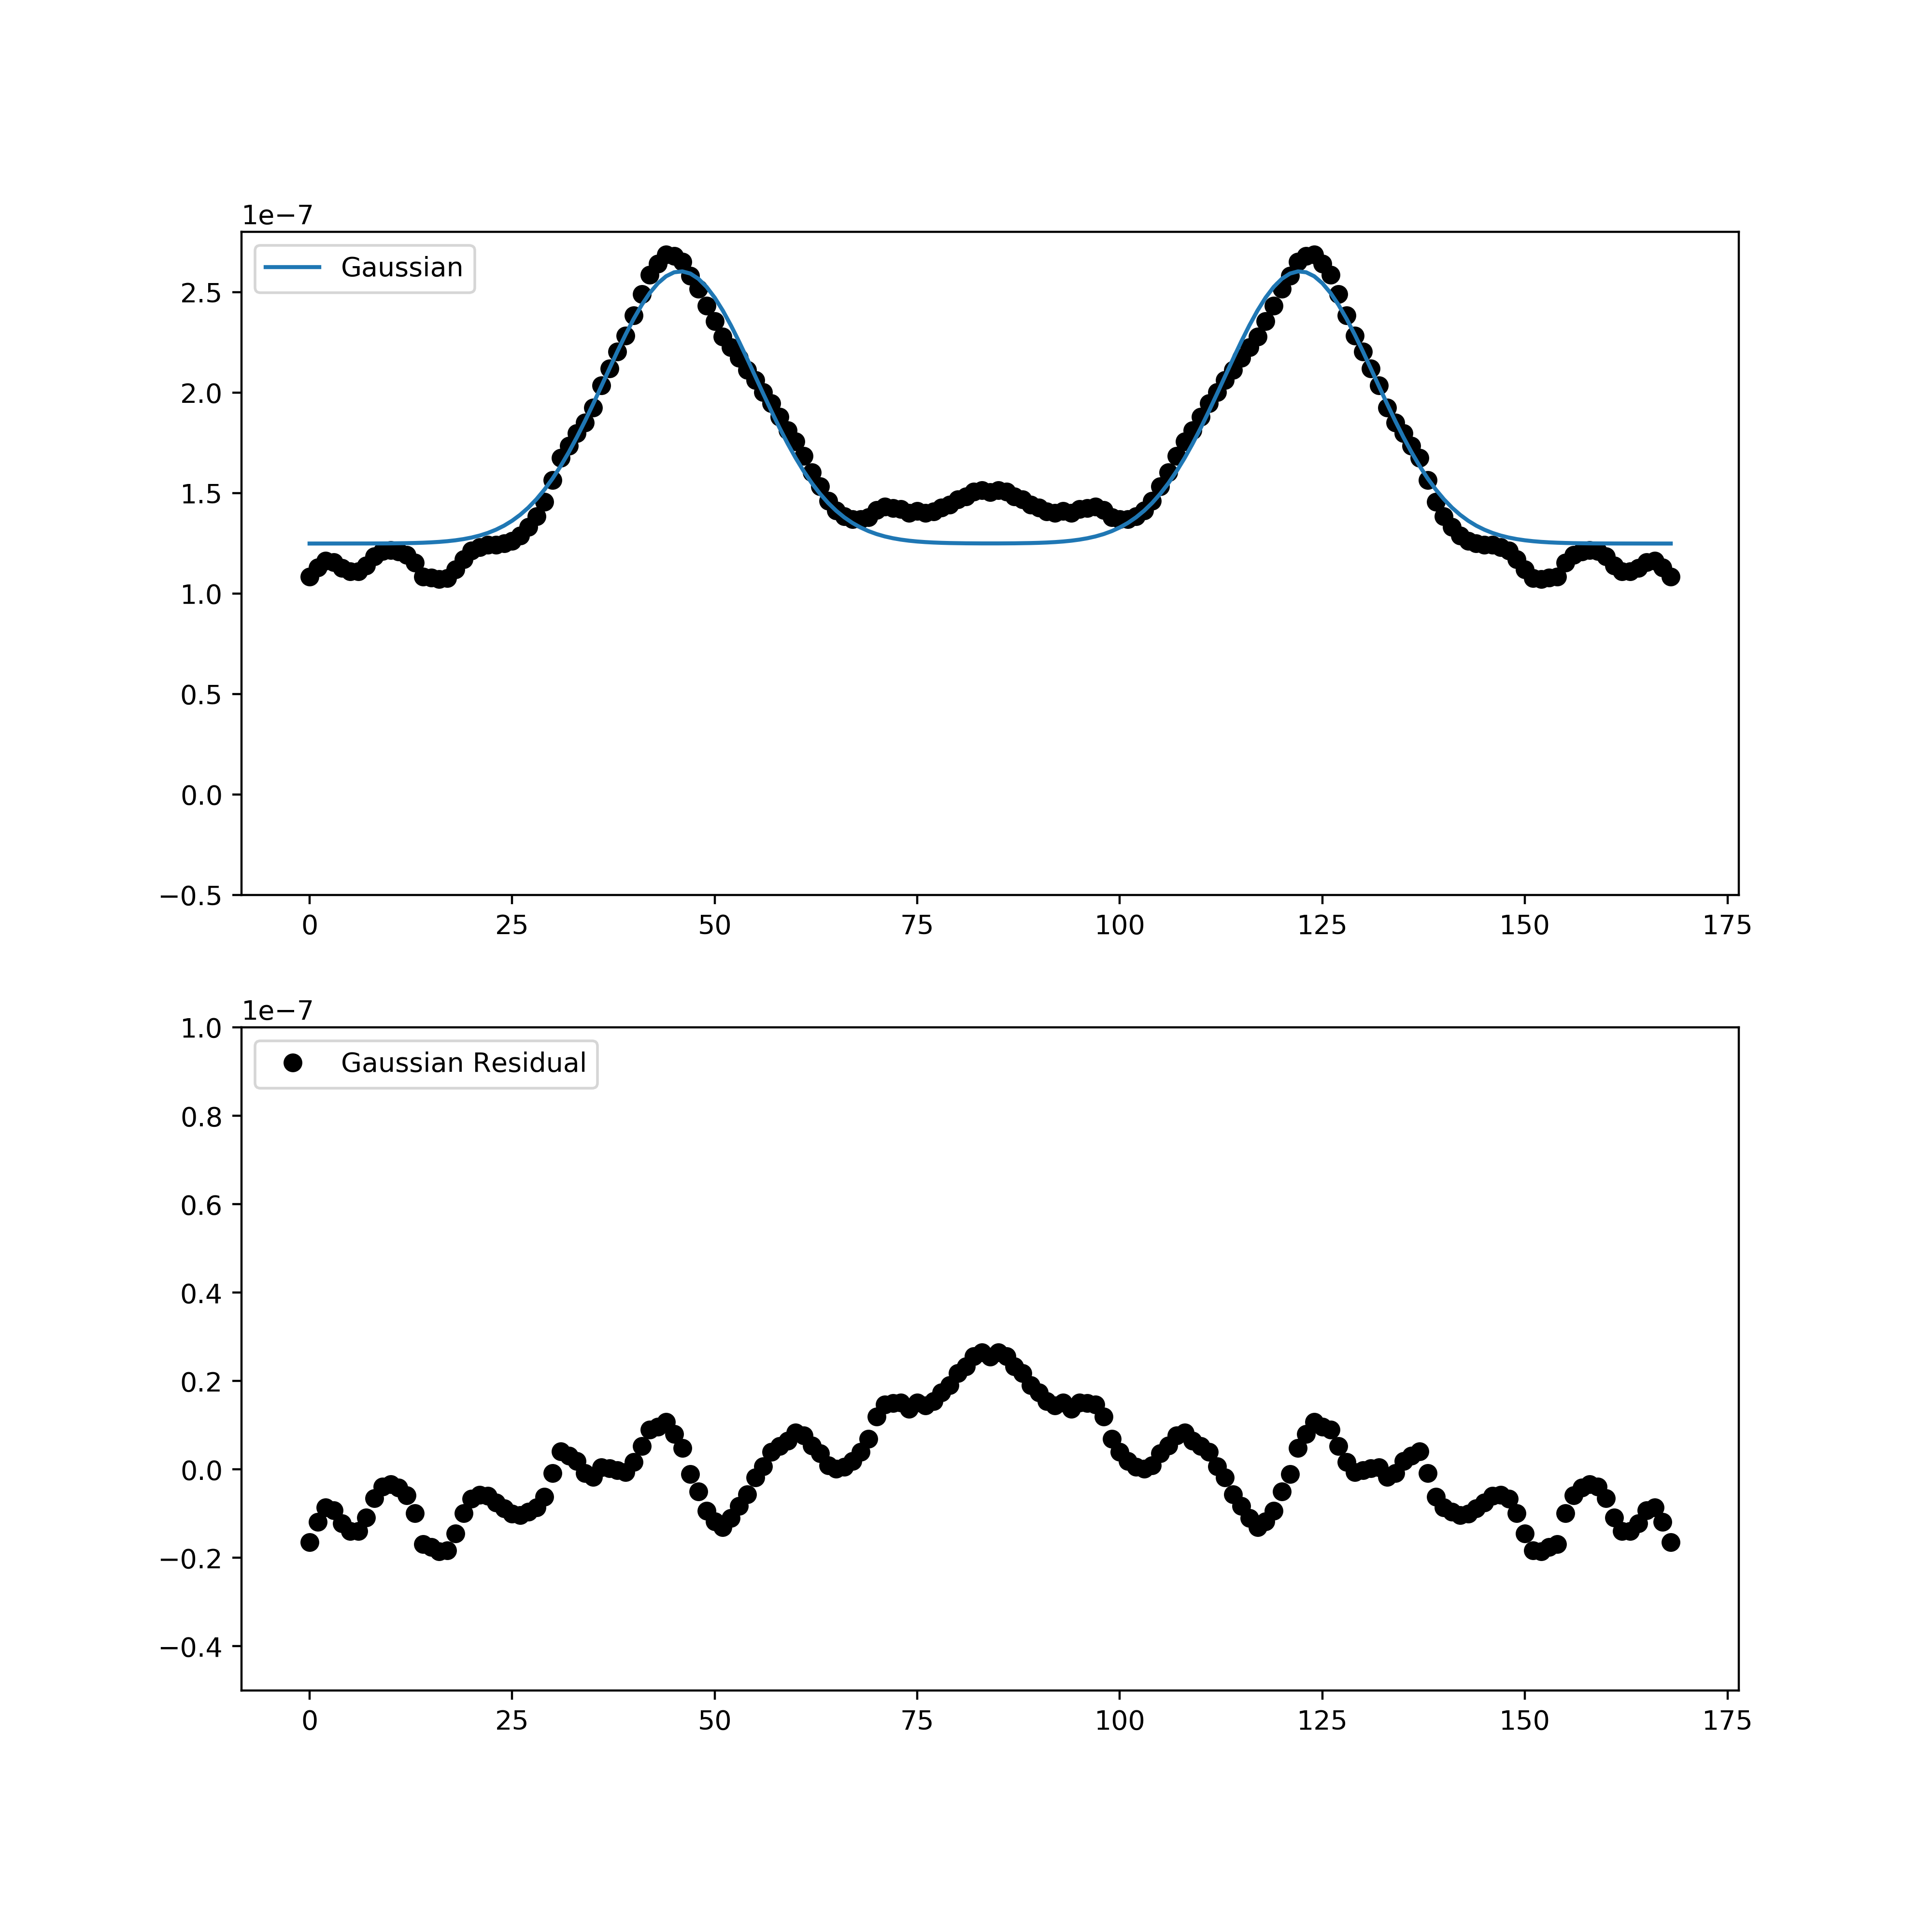
Notes:
To be sure that we have detected a signal, and not an artefact of the data processing algorithm, we also perform a stack of unphysical pairs, ones we know won’t have a filament connecting them. These pairs have the same transverse separation conditions as the physical pairs, but line of sight separations of more than 150 megaparsecs. This produces a map shown like the one above, and when we perform the same fit as for our physical pairs, it extracts a measurement consistent with noise.

Slide 17
Filament Signal
Source | Mean Residual Filament tSZ Signal | Precision
This Work | 1.29 * 10⁻⁸ | 2.05
Tanimura et al. (2017) | 1 * 10⁻⁸ | 5.3
de Graaf et al. (2017) | 0.6 * 10⁻⁸ | 5.1
Notes:
This compares very well to previous analyses performed with this technique on lower resolution Planck Maps. Tanimura et al found a mean y parameter of 1 times 10^-8 at 5.3 sigma, and de Graaf et al found a mean y parameter of 0.6 times 10^-8 at 5.1 sigma. These works constrained this number to an actual baryon component fraction by making use of complex simulations. This corresponded to exactly the measure of baryons needed to fill the missing component of phase space as required.

Slide 18
Future Work
This algorithm can be applied to other tracers of large scale structure, such as Kinetic Sunyaev Zeldovich Effect (kSZ), and Gravitational Weak Lensing Convergence (κ)
Cross-correlations give a better measure of the agreement between these, but are much harder to model, and require more detailed models to constrain
Can also be correlated with other astrophysical sources, such as Fast Radio Bursts (FRBs), or 21cm Absorption.
Notes:
Further work: This algorithm can be applied to any significant tracer of large scale structure. Thermal SZ has a counterpart related to the bulk velocity of the gas, known as the Kinetic SZ effect, which also works well, but requires a different analysis. The weak gravitational lensing convergence, kappa, also provides a good tracer for this. These signals can also be cross-correlated, along with other astrophysical signals such as Fast Radio Bursts, and the 21cm absorption signal.

Slide 19

Conclusions
Detection of missing baryons, with mean filamentary Compton y measure of 1.29 * 10⁻⁸
Comparable, but lower than previous work, due to differences in errors assosciated with the datasets, or issues with modelling
Algorithm can reasonbly be applied to multiple independent datasets, which would also improve the confidence of detection, as well as opening the door for cross-correlations
Notes:
In conclusion, we make a detection of the missing baryons in the Dark Energy Survey and South Pole Telescope data, at some level of significance. Issues with modelling, and the differences in the galaxy catalogue contribute to this being a less precise measure, but with more work, this could be further reduced. However the technique can reasonably be applied to a number of independent datasets, and so it opens the possiblity for improved detections by making the use of cross-correlations.

